Slide 1

Understanding and Integrating the Sixth Circuit’s Cable Order
Best Practices and Next Steps
July 15, 2021

Slide 2


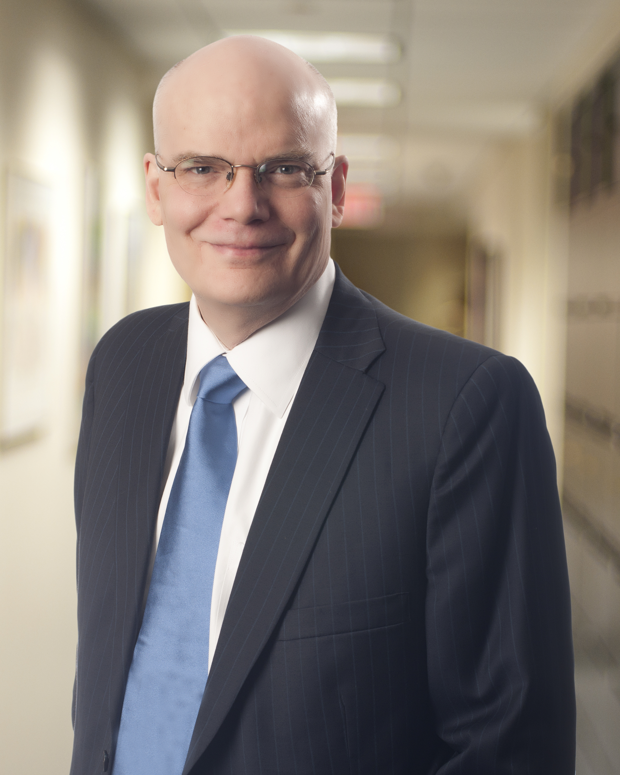
Presenters
Joseph Van Eaton
Gerard Lederer
Tillman Lay
Disclaimer: BB&K and Spiegel and McDiarmid LLP presentations and webinars are not intended as legal advice. Additional facts, facts specific to your situation or future developments may affect subjects contained herein. Seek the advice of an attorney before acting or relying upon any information herein. Audio or visual recording of this presentation and webinar content is prohibited without express prior consent.

Slide 3
Program
Outline the FCC’s 621 Order – “In-Kind” and “Mixed Use.”
What the FCC Order, as interpreted by 6th Circuit, means to all franchising authorities. (Local and State cable franchising authorities)
Provide an update on continued efforts to address the Order in the Courts and at the FCC.
Outline ideas and suggested responses that LFAs should consider in responding to the Order. (We welcome your ideas on responses. Just type them in as questions.)
Questions?

Slide 4
The FCC’s 3rd 621 Order
On August 27, 2019, by a party line 3-2 vote, the FCC issued a Third 621 Order (84 Fed. Reg. 44,725-01).
  Most “in-kind” franchise obligations count against the Cable Act’s 5% fee cap.
  Forward-looking only. (Benefits received before 9/26/2019 are not in jeopardy.)
  Fair Market Value (FMV) of any “in-kind” franchise obligation counts against the 5% Cable fee cap, unless the obligation falls within one of the exceptions to the franchise fee provision at 47 USC 542(g)(2).
    Exceptions provide that capital costs associated with PEG channels, facilities or equipment are not franchise fees.

Slide 5
FCC’s 3rd 621 Order (cont.)
Parties are to negotiate franchise modifications to account for FMV of in-kind franchise requirements within a reasonable period of time (120 days), and any franchise provision that is inconsistent with the Order is subject to preemption.
LFAs may not regulate the provision of any non-cable services, including cable broadband, provided over a cable operator’s cable system, with the exception of channel capacity on institutional networks (I-Nets). As part of its mixed-use rule analysis, FCC ruled cable operators cannot be charged any fee, other than the 5% cable franchise fee, for use of the rights-of-way.
“[T]he rules and decisions adopted in this Order apply to state-level franchising actions and regulations.” Order at ¶ 113

Slide 6
What Is “In-Kind?”
Regulation appears at 47 CFR §76.42, “In-kind contributions”
…Such contributions, which count toward the five percent cap at their fair market value, include any non-monetary contributions related to the provision of cable service by a cable operator as a condition or requirement of a local franchise, including but not limited to:
  …Costs attributable to the provision of free or discounted cable service to public buildings, including buildings leased by or under control of the franchising authority;
  …Costs in support of public, educational, or governmental access facilities, with the exception of capital costs; and
  …Costs attributable to the construction of institutional networks.
But “In-kind, cable-related contributions do not include the costs of complying with build-out and customer service requirements.

Slide 7
In-Kind Issues/Examples
Cost of maintaining lines used to transport PEG signals from studios to cable operator count against franchise fees; cost of providing lines are capital costs and do not count against fees.
FCC determined that cost of providing PEG capacity would count against fee unless that capacity was treated as a capital cost…but agency deferred any decision on whether provision of capacity was a capital cost.
Free service to public buildings counts against fee, but what about senior discounts, and discounts for persons with disabilities?
Cost of construction of an I-Net counts against fee, but what about costs of I-Net capacity?
What falls within the ambit of customer service requirements?
  PEG listings on program guide?
Where do ROW requirements/requirements for ROW restoration, relocation and maintenance fit in?

Slide 8
Mixed-Use Rule & Impact
An LFA may not regulate the provision of any services other than cable services offered over the cable system of a cable operator, with the exception of channel capacity on I-Nets. (New 47 CFR §76.43).
As adopted, rule:
  Preempts regulation of any facilities and equipment used in the provision of any services other than cable services;
  Adopts cable operators’ argument that a cable franchise authorizes installation of any equipment in ROW, even if it is not used for cable service, including Wi-Fi and small cell facilities;
  Impedes local authority to ensure consistent regulations apply to providers of similar services using similar facilities.
FCC also ruled that Eugene’s generally applicable telecom fee is a “franchise fee” and preempted by the Cable Act – and that cable operator could only be charged cable franchise fee for use of ROW to provide non-cable services.

Slide 9
6th Circuit Decision
On May 26, 2021, the 6th Circuit:
  Largely upheld FCC’s “in-kind” decision, but found that the operator was limited to offsetting (or being paid) for the marginal cost of providing the benefit – NOT fair market value;
  Rejected the FCC’s mixed-use rule as written, concluding that LFAs may regulate non-cable services unless inconsistent with the Cable Act; and
  Rejected the FCC’s ruling that Eugene’s fee was a Cable Act “franchise fee,” but nonetheless found that other provisions of the Cable Act prevent LFAs from charging a cable operator any fee for use of the ROW use to provide non-cable broadband service.

Slide 10
In-Kind
6th Circuit affirmed FCC’s ruling that most in-kind franchise obligations count against the Cable Act’s 5 percent cap on cable franchise fees, but did so on different grounds.
  FCC found that franchise fee definition reached all costs the operator was required to incur to comply with franchise obligations except for customer service standards (because those were regulatory), and except for build-out requirements (because the Cable Act requires that the cost of the installation, construction, operation, or removal facilities necessary to the cable system be borne by the cable operator or subscriber).
  Sixth Circuit agreed customer service requirements were regulatory, but otherwise decided that franchise requirements mandated by federal law did not count against the franchise fee, but all discretionary franchise requirements do. Court found that “anti-redlining” provisions in Cable Act mandated build-out.
  The court ignored the ramifications of the FCC’s conclusion that cable operators must pay for the whole cable system, which includes PEG capacity and I-Nets.

Slide 11
In-Kind (cont.)
The court reversed the FCC’s ruling that in-kind franchise obligations should be valued at fair market value and affirmatively ruled that “for purposes of § 542(b), noncash cable-related exactions should be assigned a value equal to the cable operator’s marginal cost in providing them.”
  Ruling appears to stem from statutory interpretation, which means we would have a good argument the FCC could not reinterpret the Act to undo this finding.
In some cases, marginal cost may prove to be zero, or near-zero – costs of free service, for example, or costs of maintenance of portions of the cable system.
There is no guidance, however, as to how marginal costs are to be calculated, and operators can be expected to seek the right to take significant offsets.

Slide 12
Mixed Use
6th Circuit Overturned:
FCC’s Mixed Use Rule: As codified, stated a “franchising authority may not regulate the provision of any services other than cable services offered over the cable system of a cable operator,” 47 C.F.R. § 76.43.
Court stated it agreed with localities’ challenge “[t]o a significant extent,” because “the Act nowhere states or implies that franchisors may regulate cable operators only as ‘expressly permitted in the Act.’”
Court criticized the FCC’s broad language and the FCC’s reliance on what the FCC called the cable franchise “bargain.”
But court agreed with the FCC that LFAs may “not ‘end-run’ the Act’s limitations by using other governmental entities or other sources of authority to accomplish indirectly what franchising authorities are prohibited from doing directly.”

Slide 13
Mixed Use – Application to Fees On Non-Cable Services
Rejecting the FCC’s position, the court agreed with Eugene that its generally applicable telecom fee was not a “franchise fee” within the meaning of the Cable Act, 47 U.S.C. 542(g).
But the court went on to rule that Eugene’s fee, as applied to a cable operator’s provision of broadband service, was a “requirement … for information services” prohibited by the Cable Act, 47 U.S.C. 544(b)(1).
Court believed that because Eugene’s fee was for use of the ROW to provide non-cable services, it was an “end run” around the Act’s limitations.
Court never explained how imposing a fee that is not a “franchise fee” is an “end run” around the Act, and overlooked the Act’s tax savings clause.
Court declined to reach question whether application of Eugene’s fee to a cable operator’s telecommunications (i.e., non-information) services was permissible.
Court suggested additional fees (reaching broadband and other services) might be imposable if not done as an effective exercise of the franchising authority (i.e., in return for right to use RoW).
  FL. Uniform Tax? Impact of Internet Tax Freedom Act?

Slide 14
What Happens Next? – The Courts
In the Courts
Three petitions for en banc and panel rehearing filed on July 12th.
  Whether rehearing is granted should be determined quickly.
If petitions are unsuccessful, there will be the option of seeking Supreme Court review.

Slide 15
What Happens Next? – At the Commission
It may be possible to obtain some clarifications or changes to rule at FCC.
The FCC’s Acting Chair, as well as the other current Democratic Commissioner, did not support the FCC’s Order. The FCC sought a delay in this litigation because it might change its position before the court ruled, but the court denied the FCC’s request.
Timing for action at the FCC is fluid:
  There are no legal deadlines and the timeline would likely be strongly influenced by discussions with the FCC leadership and, especially, the timing of FCC nominations and confirmations.
Goals could include:
  Making clear “customer service obligations” reach issues like compliance with customer service standards, privacy, EEO, or any rule affecting customer-cable operator relationship;
  Clarifying treatment of PEG capacity;
  Clarifying no cost associated with construction, operation or maintenance of the cable system counts against franchise fee;
  Re-construing the Act to clarify that if a fee is not a “franchise fee”, it is not preempted by the Cable Act.

Slide 16
How Should You Respond to In-Kind Now?
No need for LFA to raise issue – FCC rules contemplate notice before offsets.
If you agree to an offset, you may be bound by offset even if the FCC/courts change course. Possible: include provisions for terminating/altering offsets.
Know the rules! Costs limited to marginal costs – seek proof, where appropriate. Unless the amount proposed by operator is small, do not take operator’s word for it.
Rules do not address what happens where a capital obligation is imposed, but operator is given voluntary option of satisfying obligation through provision of a service: e.g. rather than build a line to carry PEG programming, operator provides funds or services that allow for more cost-effective transport. Alternative performance requirements may not trigger offsets.
Rules do not prevent settlements of past performance/franchise non-compliance issues that provide benefits, which are not a “franchise fee.”
Remember that Cable Act requires any costs recovered through franchise fee offset (i.e., a reduction in franchise fees) must be passed through to subscribers.

Slide 17
How Should You Respond to “Mixed Use” Now?
Be careful not to lock in current fee rule to franchise agreement, or to agree not to regulate non-cable services.
Understand rule gives operators incentives to shift revenues to “non-cable” services. This may be a significant issue to watch for in franchise fee audits.
6th Circuit decision suggests localities may have broader authority over facilities owned by telcos and used to provide cable service than telcos have claimed. May be important for safety regulation.
Because operators are including WiFi and true wireless radios on strand, it is important to ensure your franchise does not exempt any portion of the system from ROW/zoning rules as applicable – and to make sure your wireless rules take into account the position taken by the operator with respect to
  Whether additional franchises/fees may be required;
  Whether additional regulatory approvals may be required before installation.

Slide 18
Questions?
Joseph Van Eaton
joseph.vaneaton@bbklaw.com
Gerard Lederer
gerard.lederer@bbklaw.com
Tillman Lay
tim.lay@spiegelmcd.com

